Slide 1
Final Demonstration
Ketan, Eric, Sunny, Tim, Eddie

Slide 2
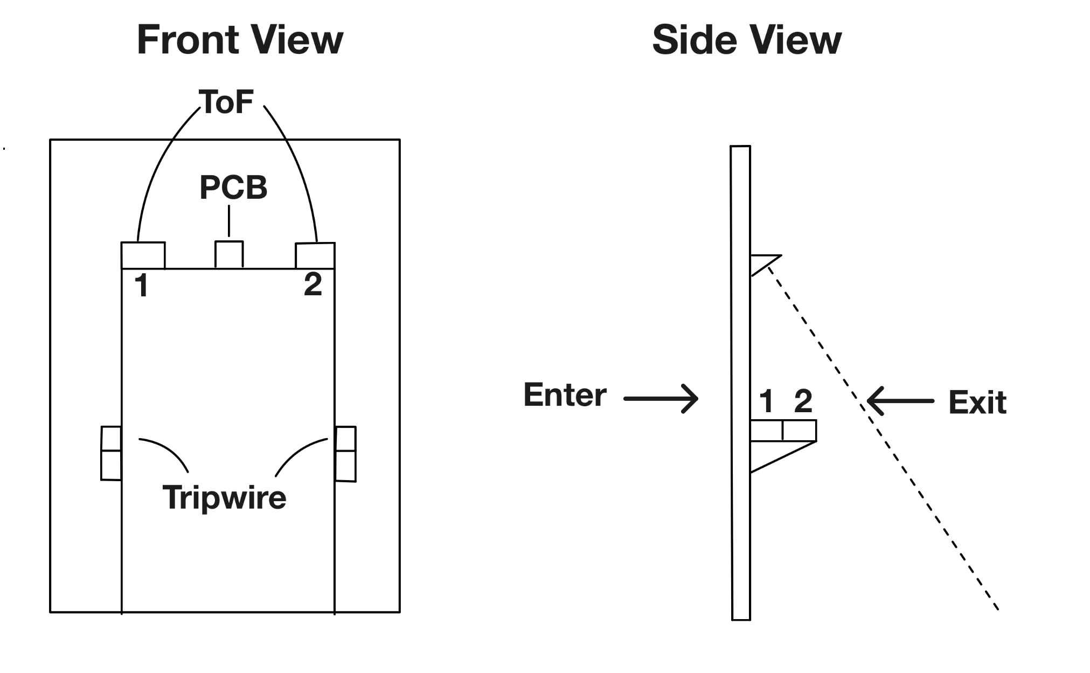
System Design

Slide 3
Power Consumption Analysis
Battery Capacity = 2200 mAh
E3F sensors average current consumption = 8 mA
TOF sensors average current consumption = 16 mA
ESP-32 average current consumption = 80 mA
Resistive dividers average current consumption = 5 mA
Battery Energy = 7.4 V * 2.2Ah = 16.28 Wh
Battery Life = 2200 mAh / (80 + 2 * 8 + 2 * 16 + 5) mA = 16.5 hours

